Slide 1
Authenticated Encryption
E&A

Slide 2


+
Authenticated encryption

Slide 3
Authenticated Encryption
Nonce N
Plaintext M
Associated data A
AE.Enc_K
Ciphertext C
Tag T
Associated data A

Slide 4
Plaintext M
Associated data A
Yes
No
T’ = T?
⊥
AE.Dec_K
Nonce N
Ciphertext C
Tag T
Associated data A

Slide 5

Short History of AE
2018
NIST Lightweight Cryptography
Security
Applicability
Robustness
2013
CAESAR
2007
ISO/IEC 19772: 2007
GCM
NIST、802.11i、IEEE P1619、RFC
2000
one-pass vs two pass
OCB
*

Slide 6
Confidentiality and Integrity
Encrypt with one key, MAC with another
Why not use the same key?
  Send last encrypted block (MAC) twice?
  Can’t add any security!
Use different keys to encrypt and compute MAC; it’s OK if keys are related
  But still twice as much work as encryption alone
Confidentiality and integrity with one “encryption” is a research topic
E&A

Slide 7
Integrity of Ciphertext
E_{K}
Attacker
……
C
Adv(A) = Pr[D_{K}(C) ≠ ⊥]
E&A

Slide 8
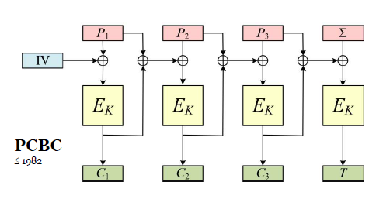
Unsuccessful One-pass Authenticated-Encryption

Slide 9
Composition of Encryption and Authentication
Encrypt-and-MAC
  E’_{Ke,Km}(M) = E_{Ke}(M) || T_{Km}(M)
MAC-then-Encrypt
  E’_{Ke,Km}(M) = E_{Ke}(M || T_{Km}(M))
Encrypt-then-MAC
  E’_{Ke,Km}(M) = E_{Ke}(M) || T_{Km}(E_{Ke}(M))
* Bellare, M., and Namprempre, C. Authenticated encryption: Relations among notions and analysis
of the generic composition paradigm. ASIACRYPT’00.
E&A

Slide 10
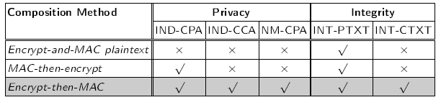
  e.g.
  If E is IND-CPA, T is INT-CTXT, then
  E’_{Ke,Km}(M) = E_{Ke}(M) || T_{Km}(M) is not IND-CPA-secure
E&A

Slide 11
Dual Counter Mode of Encryption
2001, Boyle and Salter of the NSA submitted two variants of DCM to NIST
To achieve both confidentiality and integrity
Soon broken by Donescu, Gligor, Wagner, Rogaway,…….
* P. Donescu, V. Gligor, and D. Wagner. A note on NSA’s Dual Counter Mode
of encryption. http://www.cs.berkeley.edu/~daw/papers/dcm-prelim.ps
E&A

Slide 12
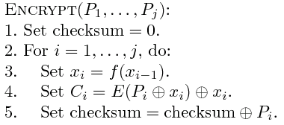


First variant of DCM
Input:
Output:
E&A

Slide 13

DCM
P₁
P₂
P_{j}
checksum
x₁
x₂
x_{j}
x_{j+1}
E_{K}
E_{K}
E_{K}
E_{K}
……
x₁
x₂
x_{j}
x₀
C₁
C₂
C_{j}
C_{j+1}
x₀
x_{i+1} =f(x_{i})
i=0…j
checksum = P₁⊕P₂ ⊕… ⊕P_{j}
x_{i+1} =x_{i}(t)t mod p(t)
E&A

Slide 14
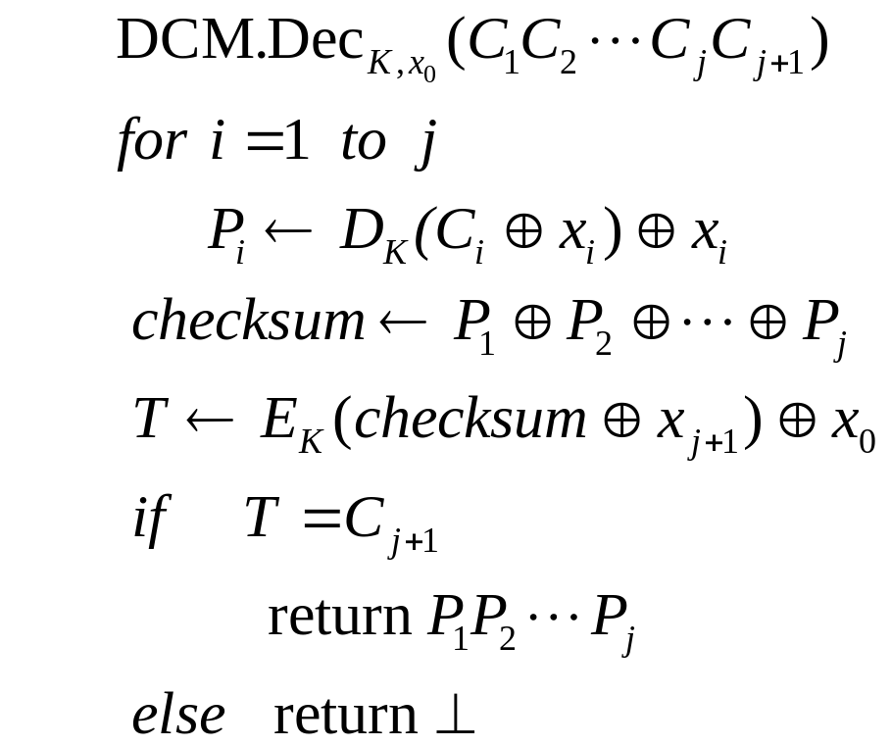
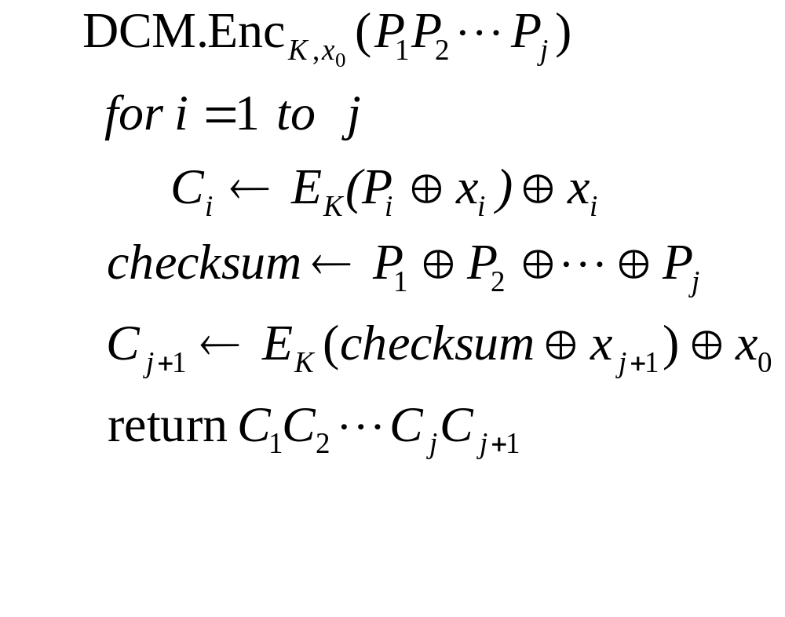
DCM
E&A

Slide 15
Integrity of Ciphertext
E_{K}
Attacker
……
C
Adv(A) = Pr[D_{K}(C) ≠ ⊥]
E&A

Slide 16
Integrity attack (1)
Observation:
  x₀⨁x_{j} reveals x₀
  x_{i+1} =x_{i}(t)t mod p(t) =>
  x₀ =(x₀⨁x_{j} )/(1+t^{j}) mod p(t)
  x₀ reveals all x_{i}
E&A

Slide 17
1) Query P=(0) and P’=(0,0), get C and C’
then C₂⨁C’₂ = x₀⨁x₂
2) Choose P = (P₁,P₂), P₁=P₂ ,
get C = (C₁,C₂,C₃)
3) Forge C’ = (C₁,C’₂) ≠ C
where C’₂ = C₂ ⨁ x₀⨁x₂
E&A

Slide 18








Integrity attack (2)
Forge
E&A

Slide 19
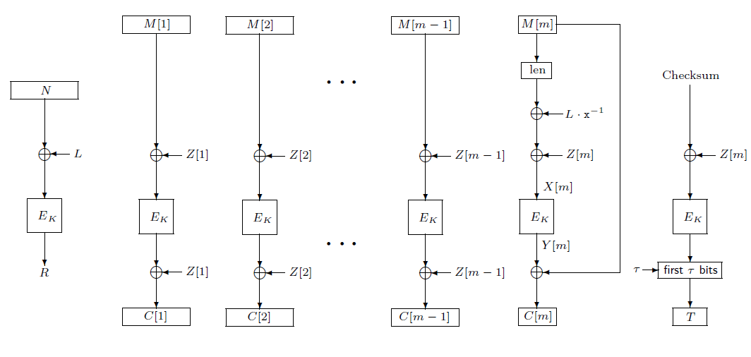
OCB
P. Rogaway, M. Bellare, and J. Black. OCB: A block-cipher mode of operation for effcient authenticated encryption. CCS 2001.

